Slide 1
Convolutional Neural Networks
2018年春节学期
王津
2018-5-31

Slide 2
Outline
The Convolution Operation
Motivation
Pooling
Convolution and Pooling as an Inﬁnitely Strong Prior
CNN history
LeNet
AlexNet
VGG
GoogLeNet
ResNet

Slide 3
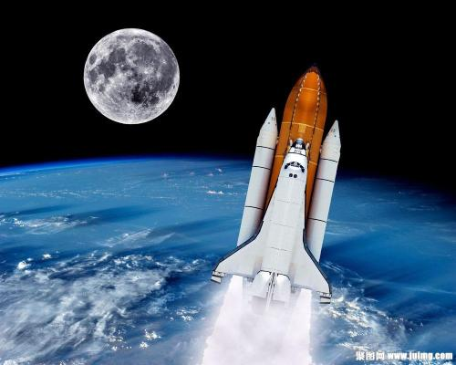
The Convolution Operation
Tracking the location of a spaceship with a laser sensor
x(t) is a single output, the position of the spaceship at time t
weighted function w(a) is used to average x(t)
More recent measurements are more relevant and be assigned more weight

Slide 4
The Convolution Operation
Convolution
x(t) is input
w(t) is kernel function
s(t) is feature map

Slide 5
The Convolution Operation
Two-dimensional kernel K:
Convolution is commutative
As in image processing, the convolution operation is usually used to extract local feature map iteratively.

Slide 6
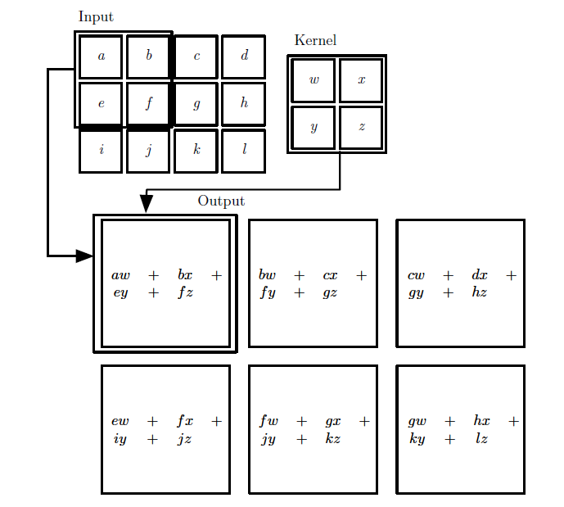
The Convolution Operation
Kernel (filters)
Kernel Size
Stride
Padding

Slide 7
The Convolution Operation
Another example

Slide 8
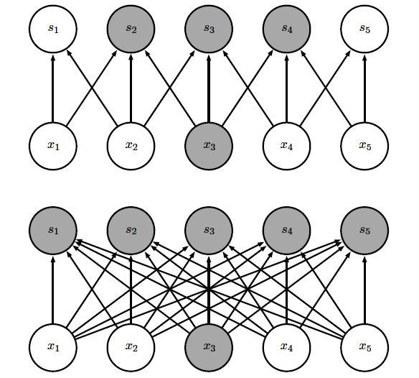
Motivation
Sparse interactions
Considering here is m inputs and n outputs
The matrix multiplication for full connection models requires m×n parameters and O(m×n) runtime
If the number of connections were limied to k, then the sparsely connected approach requires only k×n parameters and O(k×n) runtime

Slide 9

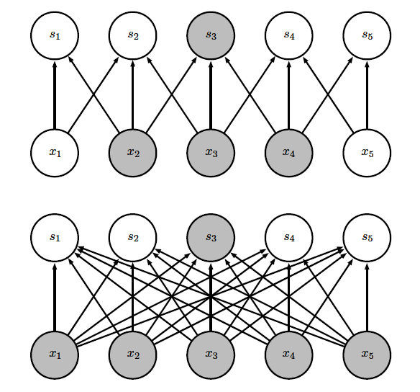
Motivation
Parameter sharing
In traditional neural network, the matrix multiplication in each layer is used exactly once when computing the output of a layer.
In convolution, each member of the kernel is used at every position of the input

Slide 10
Motivation
An example of both of these ﬁrst two principles in edge detection
The size of image is (320, 280)
Convolution needs only 319× 280×3 = 267,960 operations.
By using matrix multiplication, there will be 16B operations.

Slide 11
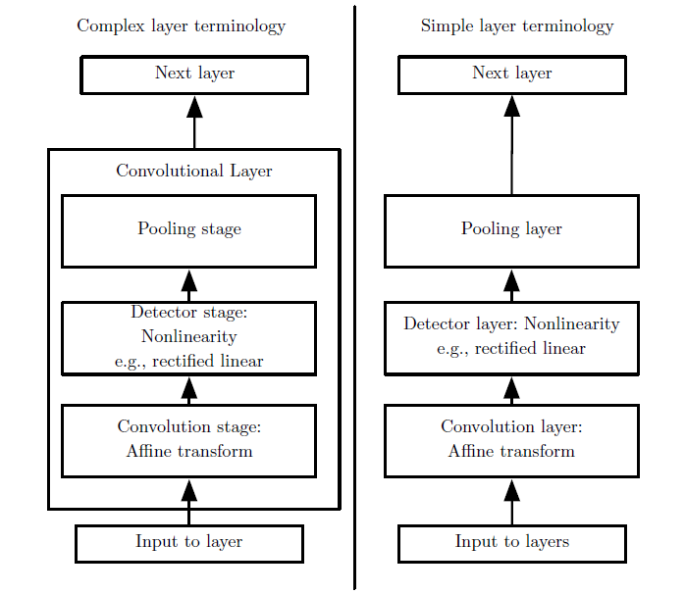
Pooling
Convolution
Nonlinearity function
ReLU (Rectified Linear Units)
Pooling
Max-pooling
Mean-pooling

Slide 12
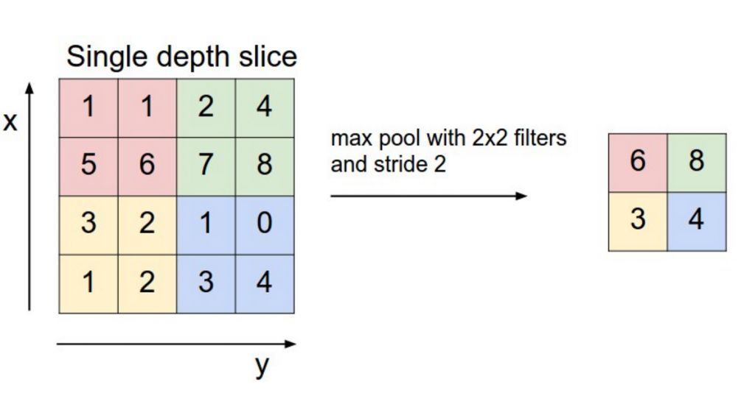
Pooling

Slide 13
Programming task
Convolutional Neural Networks for MNIST
Tensorflow
Keras

Slide 14
TensorFlow
Loading data
train_file = os.path.join('data', 'train.csv')
test_file = os.path.join('data', 'test.csv')
x_train, y_train = load_train_data(train_file)
x_test = load_test_data(test_file)
y_train = np_utils.to_categorical(y_train)
import tensorflow as tf
sess = tf.InteractiveSession()

Slide 15
TensorFlow
Utility function
def weight_variable(shape):
initial = tf.truncated_normal(shape, stddev=0.1)
return tf.Variable(initial)
def bias_variable(shape):
initial = tf.constant(0.1, shape=shape)
return tf.Variable(initial)
def conv2d(x, W):
# stride [1, x_movement, y_movement, 1]
# Must have strides[0] = strides[3] = 1
return tf.nn.conv2d(x, W, strides=[1, 1, 1, 1], padding='SAME')
def max_pool_2x2(x):
# stride [1, x_movement, y_movement, 1]
return tf.nn.max_pool(x, ksize=[1, 2, 2, 1], strides=[1, 2, 2, 1], padding='SAME')

Slide 16
TensorFlow
Placeholder
Convolutional layer
x = tf.placeholder("float", shape=[None, 784]) # 784＝28x28
y_ = tf.placeholder("float", shape=[None, num_classes])
W_conv1 = weight_variable([3, 3, 1, 32]) # patch 5x5, in size 1, out size 32
b_conv1 = bias_variable([32])
x_image = tf.reshape(x, [-1, 28, 28, 1])
h_conv1 = tf.nn.relu(conv2d(x_image, W_conv1) + b_conv1) # output size 28x28x32

Slide 17
TensorFlow
Max-pooling layer
Dense layer
h_pool1 = max_pool_2x2(h_conv1) # output size 14x14x32
W_fc1 = weight_variable([14 * 14 * 32, 128])
b_fc1 = bias_variable([128])
h_pool2_flat = tf.reshape(h_pool1, [-1, 14 * 14 * 32])
h_fc1 = tf.nn.relu(tf.matmul(h_pool2_flat, W_fc1) + b_fc1)
keep_prob = tf.placeholder("float")
h_fc1_drop = tf.nn.dropout(h_fc1, keep_prob)

Slide 18
TensorFlow
Output layer
Loss function
Optimizer
W_fc2 = weight_variable([128, num_classes])
b_fc2 = bias_variable([num_classes])
y_conv = tf.nn.softmax(tf.matmul(h_fc1_drop, W_fc2) + b_fc2)
loss = -tf.reduce_sum(y_ * tf.log(y_conv))
optimizer = tf.train.AdamOptimizer(1e-4).minimize(loss)

Slide 19
TensorFlow
Accuracy Calculator
Training
correct_prediction = tf.equal(tf.argmax(y_conv, 1), tf.argmax(y_, 1))
accuracy = tf.reduce_mean(tf.cast(correct_prediction, "float"))
sess.run(tf.initialize_all_variables())
for epoch in range(epochs):
for idx in range(len(x_train)//batch_size):
x_batch = x_train[idx*batch_size:(idx+1)*batch_size]
y_batch = y_train[idx*batch_size:(idx+1)*batch_size]
if idx % 10 == 0:
train_accuracy = accuracy.eval(feed_dict={
x: x_batch, y_: y_batch, keep_prob: 1.0})
print("epoch %d, batch: %d, training accuracy %g" % (epoch, idx, train_accuracy))
optimizer.run(feed_dict={x: x_batch, y_: y_batch, keep_prob: 0.5})

Slide 20
TensorFlow
Prediction
y_pred = []
for idx in range(len(x_test)//batch_size):
x_test_batch = x_test[idx*batch_size:(idx+1)*batch_size]
y_pred_batch = sess.run(y_conv, {x: x_test_batch, keep_prob: 1.0})
y_pred_batch = np.argmax(y_pred_batch, axis=-1)
for j in range(len(y_pred_batch)):
y_pred.append(y_pred_batch[j])
save_file = os.path.join('result', 'cnn_tensorflow.csv')
save_result(y_pred, save_file)
sess.close()

Slide 21
Keras
Import Keras
Load data
from keras.layers import Dense, Input, Conv2D, Reshape, Dropout, MaxPooling2D, Flatten
from keras.models import Model
train_file = os.path.join('data', 'train.csv')
test_file = os.path.join('data', 'test.csv')
x_train, y_train = load_train_data(train_file)
x_test = load_test_data(test_file)
print(x_train.shape)
y_train = np_utils.to_categorical(y_train)

Slide 22
Keras
Model
input_layer = Input(shape=(784, ))
reshape_layer = Reshape((28, 28, 1)) (input_layer)
conv_layer = Conv2D(filters=32, kernel_size=(3, 3), activation='relu') (reshape_layer)
pooling_layer = MaxPooling2D(pool_size=(2, 2)) (conv_layer)
dropout_layer_1 = Dropout(0.25) (pooling_layer)
flatten_layer = Flatten()(dropout_layer_1)
hidden_layer = Dense(128, activation='relu') (flatten_layer)
dropout_layer_2 = Dropout(0.5) (hidden_layer)
output_layer = Dense(num_classes, activation='softmax') (dropout_layer_2)
model = Model(input_layer, output_layer)
model.compile(loss='categorical_crossentropy',
optimizer='adam',
metrics=['accuracy'])

Slide 23
Keras
Training
Prediction
model.fit(x_train, y_train,
batch_size=batch_size,
epochs=epochs,
verbose=1)
y_pred = np.argmax(model.predict(x_test), axis=-1)
save_file = os.path.join('result', 'cnn_keras.csv')
save_result(y_pred, file_name=save_file)

Slide 24
卷积神经网络
CNN的发展史
最早的Deep Learning概念被提出来的时候，其实所指的并不是CNN，最早是指所提出来的限制波茨曼机（Restricted Boltzmann Machine）、深度致信网络（Deep Believe Net）。
当时有流传的段子是Hinton的学生在台上讲paper时，台下的机器学习大牛们不屑一顾，质问你们的东西有理论推导吗？有数学基础吗？搞得过SVM之类吗？回头来看，就算是真的，大牛们也确实不算无理取闹，是骡子是马拉出来遛遛，不要光提个概念。
时间终于到了2012年，Hinton的学生Alex Krizhevsky在寝室用GPU死磕了一个Deep Learning模型，一举摘下了视觉领域竞赛ILSVRC 2012的桂冠，在百万量级的ImageNet数据集合上，效果大幅度超过传统的方法，从传统的70%多提升到80%多。

Slide 25
卷积神经网络
CNN的发展史
这个Deep Learning模型就是后来大名鼎鼎的AlexNet模型。这从天而降的AlexNet为何能耐如此之大？有三个很重要的原因：
大量数据，Deep Learning领域应该感谢李飞飞团队搞出来如此大的标注数据集合ImageNet；
GPU，这种高度并行的计算神器确实助了洪荒之力，没有神器在手，Alex估计不敢搞太复杂的模型；
算法的改进，包括网络变深、数据增强、ReLU、Dropout等，这个后面后详细介绍。

Slide 26
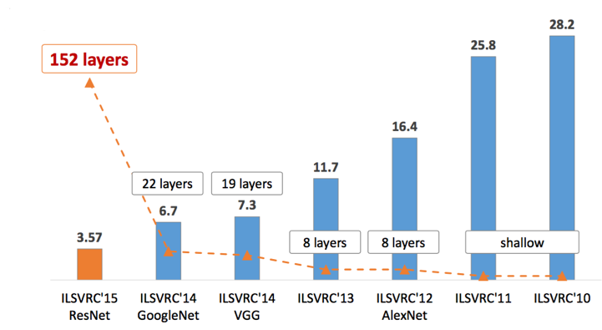
卷积神经网络
从此，Deep Learning一发不可收拾，ILSVRC每年都不断被Deep Learning刷榜，如图1所示，随着模型变得越来越深，Top-5的错误率也越来越低，目前降到了3.5%附近，而在同样的ImageNet数据集合上，人眼的辨识错误率大概在5.1%，也就是目前的Deep Learning模型的识别能力已经超过了人眼。

Slide 27
卷积神经网络
最古老的CNN模型
1985年，Rumelhart和Hinton等人提出了后向传播（Back Propagation，BP）算法（也有说1986年的，指的是他们另一篇paper：Learning representations by back-propagating errors)，使得神经网络的训练变得简单可行，这篇文章在Google Scholar上的引用次数达到了19000多次，目前还是比Cortes和Vapnic的Support-Vector Networks稍落后一点，不过以Deep Learning最近的发展劲头来看，超越指日可待。

Slide 28
卷积神经网络
几年后，LeCun利用BP算法来训练多层神经网络用于识别手写邮政编码[1]，这个工作就是CNN的开山之作，如图2所示，多处用到了5*5的卷积核，但在这篇文章中LeCun只是说把5*5的相邻区域作为感受野，并未提及卷积或卷积神经网络。关于CNN最原始的雏形感兴趣的读者也可以关注一下文献[2]。
[1] Y. LeCun , B. Boser , J. S. Denker , D. Henderson , R. E. Howard , W. Hubbard and L. D. Jackel, “Backpropagation applied to handwritten zip code recognition”, Neural Computation, vol. 1, no. 4, pp. 541-551, 1989.
[2] K. Fukushima. Neocognitron: A self-organizing neural network model for a mechanism of pattern recognition unaffected by shift in position. Biological Cybernetics, 36(4): 93-202, 1980.

Slide 29
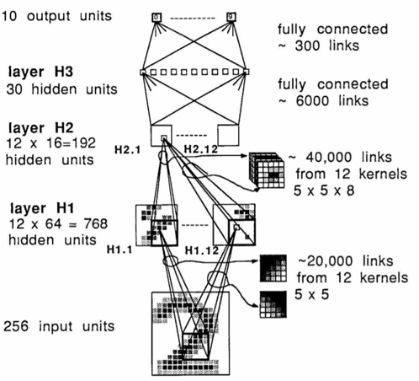
卷积神经网络

Slide 30
卷积神经网络
LeNet
1998年的LeNet5[3]标注着CNN的真正面世，但是这个模型在后来的一段时间并未能火起来，主要原因是费机器（当时苦逼的没有GPU啊），而且其他的算法（SVM，老实说是你干的吧？）也能达到类似的效果甚至超过。
[4] Y. LeCun, L. Bottou, Y. Bengio, and P. Haffner. Gradient-based learning applied to document recognition. Proceedings of the IEEE, 86(11):2278–2324, 1998.

Slide 31
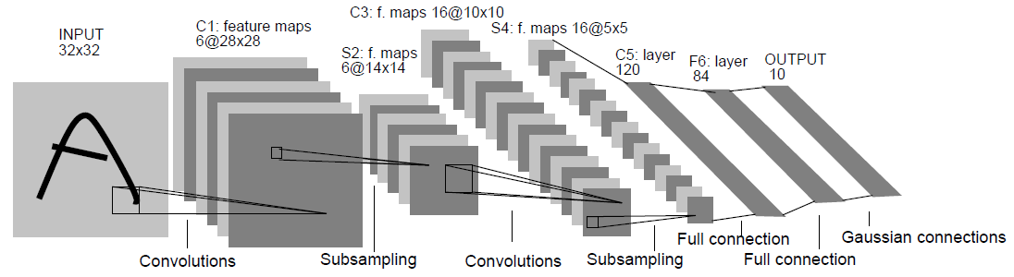
卷积神经网络

Slide 32
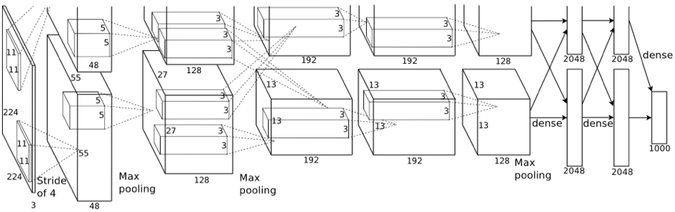
卷积神经网络
AlexNet
AlexNet曾使用了两个通道，结构如下图：

Slide 33
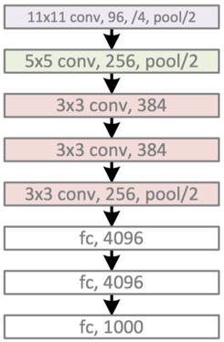
卷积神经网络
AlexNet
换个视角

Slide 34
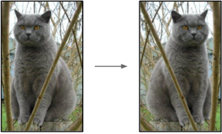
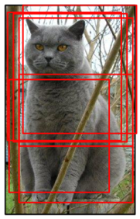
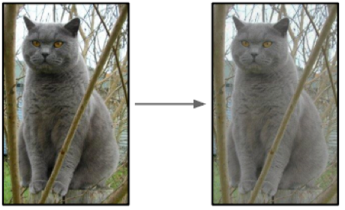
卷积神经网络
AlexNet的重要改动：
Data Augmentation
水平翻转
随机裁剪、平移变换
颜色、光照变换

Slide 35
卷积神经网络
Dropout
Dropout方法和数据增强一样，都是防止过拟合的。Dropout应该算是AlexNet中一个很大的创新，以至于Hinton在后来很长一段时间里的Talk都拿Dropout说事，后来还出来了一些变种，比如DropConnect等。
ReLU激活函数
用ReLU代替了传统的Tanh或者Logistic。好处有：
ReLU本质上是分段线性模型，前向计算非常简单，无需指数之类操作；
ReLU的偏导也很简单，反向传播梯度，无需指数或者除法之类操作；
ReLU不容易发生梯度发散问题，Tanh和Logistic激活函数在两端的时候导数容易趋近于零，多级连乘后梯度更加约等于0；
ReLU关闭了右边，从而会使得很多的隐层输出为0，即网络变得稀疏，起到了类似L1的正则化作用，可以在一定程度上缓解过拟合。

Slide 36
卷积神经网络
Local Response Normalization
Local Response Normalization要硬翻译的话是局部响应归一化，简称LRN，实际就是利用临近的数据做归一化。这个策略贡献了1.2%的Top-5错误率。
Overlapping Pooling
Overlapping的意思是有重叠，即Pooling的步长比Pooling Kernel的对应边要小。这个策略贡献了0.3%的Top-5错误率。
多GPU并行
这个不多说，比一臂之力还大的洪荒之力。

Slide 37
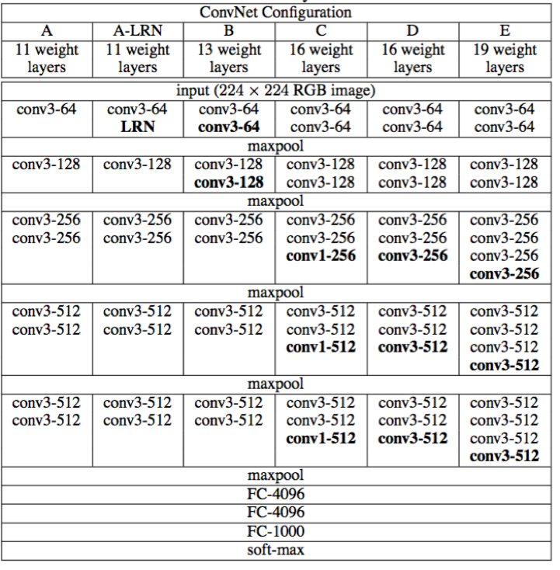
卷积神经网络
VGG

Slide 38
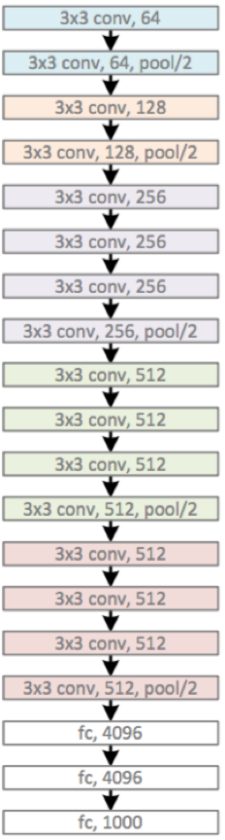
卷积神经网络
VGG
VGG很好地继承了AlexNet的衣钵，一个字：深，两个字：更深。

Slide 39
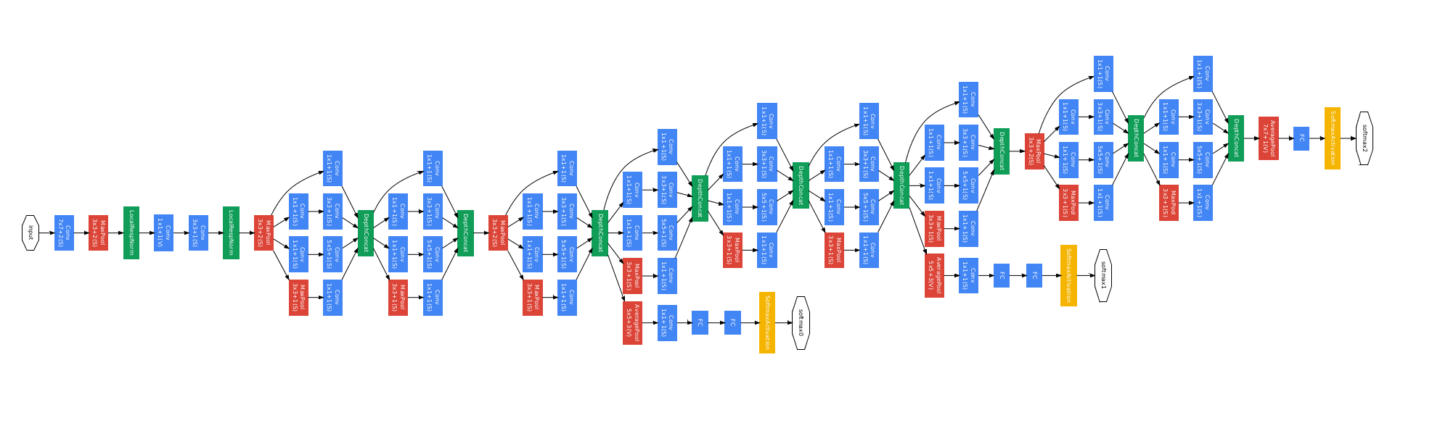
卷积神经网络
GoogLeNet
GoogLeNet依然是：没有最深，只有更深。

Slide 40
卷积神经网络
GoogLeNet
主要的创新在于他的Inception，这是一种网中网（Network In Network）的结构，即原来的结点也是一个网络。Inception一直在不断发展，目前已经V2、V3、V4了，感兴趣的同学可以查阅相关资料。Inception的结构如图9所示，其中1*1卷积主要用来降维，用了Inception之后整个网络结构的宽度和深度都可扩大，能够带来2-3倍的性能提升。

Slide 41
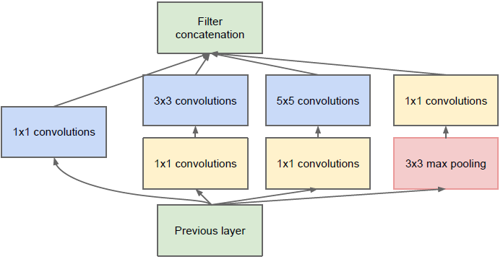
卷积神经网络

Slide 42
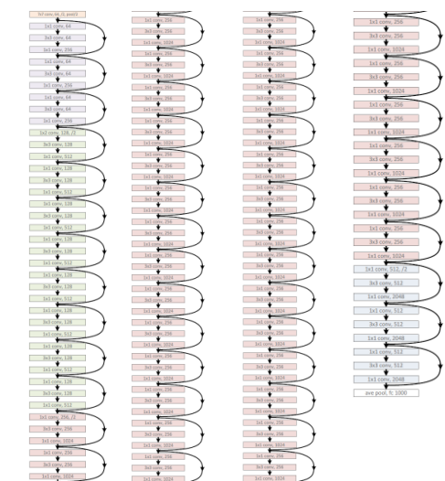
卷积神经网络
ResNet
ResNet依然是：没有最深，只有更深（152层）。听说目前层数已突破一千。

Slide 43
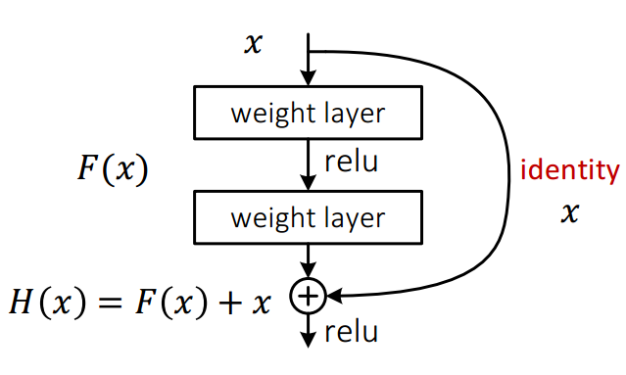
主要的创新在残差网络，如图11所示，其实这个网络的提出本质上还是要解决层次比较深的时候无法训练的问题。这种借鉴了Highway Network思想的网络相当于旁边专门开个通道使得输入可以直达输出，而优化的目标由原来的拟合输出H(x)变成输出和输入的差H(x)-x，其中H(X)是某一层原始的的期望映射输出，x是输入。

Slide 44
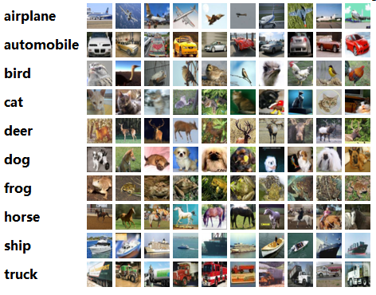
Cifar-10
Download the cifar-10 dataset
http://www.cs.toronto.edu/~kriz/cifar.html (Python version)
It contains 60000 32x32 color images in classes, witch 6000 images per class.
There are 50000 training images and 10000 testing images

Slide 45
Cifar-10
Load function
def load_test_data(file_name, normalize=True):
x_test, y_test = [], []
dict = unpickle(file_name)
for j in range(len(dict[b'data'])):
x_test.append(dict[b'data'][j])
y_test.append(dict[b'labels'][j])
x_test = np.array(x_test).astype('float32')
y_test = np.array(y_test)
if normalize == True:
x_test /= 255
return x_test, y_test
def unpickle(file):
import pickle
with open(file, 'rb') as fo:
dict = pickle.load(fo, encoding='bytes')
return dict

Slide 46
Cifar-10
Load function
def load_train_data(file_path, normalize=True):
x_train, y_train = [], []
for i in range(5):
file_name = os.path.join(file_path, 'data_batch_' + str(i+1))
dict = unpickle(file_name)
for j in range(len(dict[b'data'])):
x_train.append(dict[b'data'][j])
y_train.append(dict[b'labels'][j])
x_train = np.array(x_train).astype('float32')
y_train = np.array(y_train)
if normalize == True:
x_train /= 255
return x_train, y_train

Slide 47
Cifar-10
Load data and Reshape
x_train, y_train = load_train_data('cifar-10')
x_test, y_test = load_test_data(os.path.join('cifar-10', 'test_batch'))
x_train = np.reshape(x_train, (x_train.shape[0], 32, 32, 3))
x_test = np.reshape(x_test, (x_test.shape[0], 32, 32, 3))
print(x_train.shape)
print(y_train.shape)
print(x_test.shape)
print(y_test.shape)
y_train = np_utils.to_categorical(y_train)

Slide 48
Conventional Models
Random Forest
SVM
Evaluation
from sklearn.ensemble import RandomForestClassifier
clf = RandomForestClassifier(n_estimators=100)
from sklearn.svm import SVC
clf = SVC()
clf.fit(x_train, y_train)
y_pred = clf.predict(x_test)
from sklearn.metrics import precision_score, recall_score, accuracy_score, f1_score
print(precision_score(y_test, y_pred, average='macro'))
print(recall_score(y_test, y_pred, average='macro'))
print(accuracy_score(y_test, y_pred))
print(f1_score(y_test, y_pred, average='macro'))

Slide 49
One-layer CNN
input_layer = Input(shape=(32, 32, 3, ))
conv_layer = Conv2D(filters=32, kernel_size=(3, 3), activation='relu') (input_layer)
pooling_layer = MaxPooling2D(pool_size=(2, 2)) (conv_layer)
dropout_layer_1 = Dropout(0.25) (pooling_layer)
flatten_layer = Flatten()(dropout_layer_1)
hidden_layer = Dense(128, activation='relu') (flatten_layer)
dropout_layer_2 = Dropout(0.5) (hidden_layer)
output_layer = Dense(num_classes, activation='softmax') (dropout_layer_2)
model = Model(input_layer, output_layer)
model.compile(loss='categorical_crossentropy',
optimizer='adam',
metrics=['accuracy'])
model.fit(x_train, y_train,
batch_size=batch_size,
epochs=epochs,
verbose=1)

Slide 50
One-layer CNN
Evaluation
from sklearn.metrics import precision_score, recall_score, accuracy_score, f1_score
y_pred = np.argmax(model.predict(x_test), axis=-1)
print(precision_score(y_test, y_pred, average='macro'))
print(recall_score(y_test, y_pred, average='macro'))
print(accuracy_score(y_test, y_pred))
print(f1_score(y_test, y_pred, average='macro'))

Slide 51
Data augmentation
from keras.preprocessing.image import ImageDataGenerator
datagen = ImageDataGenerator(
featurewise_center=False, # set input mean to 0 over the dataset
samplewise_center=False, # set each sample mean to 0
featurewise_std_normalization=False, # divide inputs by std of the dataset
samplewise_std_normalization=False, # divide each input by its std
zca_whitening=False, # apply ZCA whitening
rotation_range=0, # randomly rotate images in the range (degrees, 0 to 180)
width_shift_range=0.1, # randomly shift images horizontally (fraction of total width)
height_shift_range=0.1, # randomly shift images vertically (fraction of total height)
horizontal_flip=True, # randomly flip images
vertical_flip=False) # randomly flip images
datagen.fit(x_train)
model.fit_generator(datagen.flow(x_train, y_train,
batch_size=batch_size),
epochs=epochs,
workers=4)

Slide 52
Six-layer CNN
input_layer = Input(shape=(32, 32, 3, ))
conv_layer_1 = Conv2D(filters=32, kernel_size=(3, 3), activation='relu') (input_layer)
conv_layer_2 = Conv2D(filters=32, kernel_size=(3, 3), activation='relu') (conv_layer_1)
pooling_layer_1 = MaxPooling2D(pool_size=(2, 2)) (conv_layer_2)
dropout_layer_1 = Dropout(0.25) (pooling_layer_1)
conv_layer_3 = Conv2D(filters=64, kernel_size=(3, 3), activation='relu') (dropout_layer_1)
conv_layer_4 = Conv2D(filters=64, kernel_size=(3, 3), activation='relu') (conv_layer_3)
pooling_layer_2 = MaxPooling2D(pool_size=(2, 2)) (conv_layer_4)
dropout_layer_2 = Dropout(0.25) (pooling_layer_2)
flatten_layer = Flatten()(dropout_layer_2)
hidden_layer = Dense(512, activation='relu') (flatten_layer)
dropout_layer_2 = Dropout(0.5) (hidden_layer)
output_layer = Dense(num_classes, activation='softmax') (dropout_layer_2)

Slide 53
11layer-VGG
input_layer = Input(shape=(32, 32, 3, ))
conv_layer_1 = Conv2D(filters=64, kernel_size=(3, 3), padding='same', activation='relu', kernel_initializer='he_normal') (input_layer)
conv_layer_2 = Conv2D(filters=64, kernel_size=(3, 3), padding='same', activation='relu', kernel_initializer='he_normal') (conv_layer_1)
pooling_layer_1 = MaxPooling2D(pool_size=(2, 2), strides=2, padding='same') (conv_layer_2)
conv_layer_3 = Conv2D(filters=128, kernel_size=(3, 3), padding='same', activation='relu', kernel_initializer='he_normal') (pooling_layer_1)
conv_layer_4 = Conv2D(filters=128, kernel_size=(3, 3), padding='same', activation='relu', kernel_initializer='he_normal') (conv_layer_3)
pooling_layer_2 = MaxPooling2D(pool_size=(2, 2)) (conv_layer_4)

Slide 54
11layer-VGG
conv_layer_5 = Conv2D(filters=256, kernel_size=(3, 3), padding='same', activation='relu', kernel_initializer='he_normal') (pooling_layer_2)
conv_layer_6 = Conv2D(filters=256, kernel_size=(3, 3), padding='same', activation='relu', kernel_initializer='he_normal') (conv_layer_5)
pooling_layer_3 = MaxPooling2D(pool_size=(2, 2)) (conv_layer_6)
flatten_layer = Flatten()(pooling_layer_3)
hidden_layer = Dense(512, activation='relu', kernel_initializer='he_normal') (flatten_layer)
dropout_layer_2 = Dropout(0.5) (hidden_layer)
output_layer = Dense(num_classes, activation='softmax', kernel_initializer='he_normal') (dropout_layer_2)

Slide 55
Batch Normalization
# replace x to layer_name
from keras.layers import BatchNormalization
if conv_first:
x = conv(x)
if batch_normalization:
x = BatchNormalization()(x)
if activation is not None:
x = Activation(activation)(x)
else:
if batch_normalization:
x = BatchNormalization()(x)
if activation is not None:
x = Activation(activation)(x)
x = conv(x)

Slide 56
ResNet-110
def resnet_layer(inputs, num_filters=16, kernel_size=3, strides=1, activation='relu', batch_normalization=True, conv_first=True):
conv = Conv2D(num_filters, kernel_size=kernel_size, strides=strides, padding='same', kernel_initializer='he_normal', kernel_regularizer=l2(1e-4))
x = inputs
if conv_first:
x = conv(x)
if batch_normalization:
x = BatchNormalization()(x)
if activation is not None:
x = Activation(activation)(x)
else:
if batch_normalization:
x = BatchNormalization()(x)
if activation is not None:
x = Activation(activation)(x)
x = conv(x)
return x

Slide 57
ResNet-110
def resnet_v2(input_shape, depth, num_classes=10):
if (depth - 2) % 9 != 0:
raise ValueError('depth should be 9n+2 (eg 56 or 110 in [b])')
# Start model definition.
num_filters_in = 16
num_res_blocks = int((depth - 2) / 9)
inputs = Input(shape=input_shape)
# v2 performs Conv2D with BN-ReLU on input before splitting into 2 paths
x = resnet_layer(inputs=inputs,
num_filters=num_filters_in,
conv_first=True)

Slide 58
ResNet-110
for stage in range(3):
for res_block in range(num_res_blocks):
activation = 'relu'
batch_normalization = True
strides = 1
if stage == 0:
num_filters_out = num_filters_in * 4
if res_block == 0: # first layer and first stage
activation = None
batch_normalization = False
else:
num_filters_out = num_filters_in * 2
if res_block == 0: # first layer but not first stage
strides = 2 # downsample
# bottleneck residual unit
y = resnet_layer(inputs=x, num_filters=num_filters_in, kernel_size=1, strides=strides, activation=activation, batch_normalization=batch_normalization, conv_first=False)
y = resnet_layer(inputs=y, num_filters=num_filters_in, conv_first=False)
y = resnet_layer(inputs=y, num_filters=num_filters_out, kernel_size=1, conv_first=False)

Slide 59
ResNet-110
x = BatchNormalization()(x)
x = Activation('relu')(x)
x = AveragePooling2D(pool_size=8)(x)
y = Flatten()(x)
outputs = Dense(num_classes,
activation='softmax',
kernel_initializer='he_normal')(y)
# Instantiate model.
model = Model(inputs=inputs, outputs=outputs)
return model
depth = 110
model = resnet_v2(input_shape=(32, 32, 3), depth=depth)

Slide 60
Tasks
Conventional Models
With dimensionality reduction
One-layer CNN
With data augmentation
Six-layer CNN
11-layer VGG
With batch normalization
56-layer ResNet
110-layer ResNet

